Slide 1




Team 14
Team Alpaca
Roni Fridman - Technion - Data and Science Engineering
Amit Meir - BGU - M.D.
Nati Dadon - JCT - Physics and Electro-optics Engineering
Ilya Vorotyntseb - Brauda - Software Engineering
Evgeny Lambord - Technion - Computer Science

Slide 2


Our Data
Our model is based on the “Cardiovascular Study Dataset” Which tries to predict the 10-year risk for CHD complications.
Although sparse in both rows and column, we managed to provide great results!

Slide 3
Our Model
Data Exploration
Features Creation
Missing and Imbalance handling
Deployment
POC and Results of the models
Model Selection and Hyperparameters

Slide 4
Feature Creation
After the exploring the data, we created these columns:
Packs of cigaretts based on the amount in the “cigsPerDay“ column
is the user in a state of Hypertension basen on the systolic and diastolic BP.
glucose_level: categorical cutoffs for the glucose column
diabetes_score2 : a simplified version on the well known metric for diabetes detection.
Handling Missings and Imbalance
We have tried using a KNN imputator, but found out the bias in the data is too big, and the predictions become unrelayable. We decided the use the standart method: Median for continuous values, and Mode for categorical values.
The binary target varible contained only 25% points from the ‘1’ category. Thus, we oversampled from the category using the SMOTE algorithm, which created a much more stable data.

Slide 5
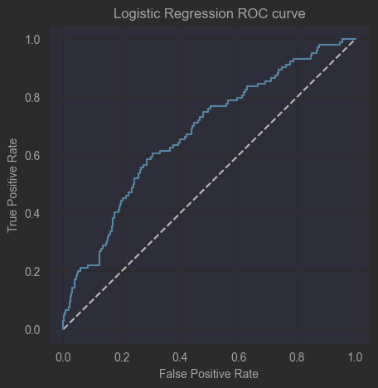
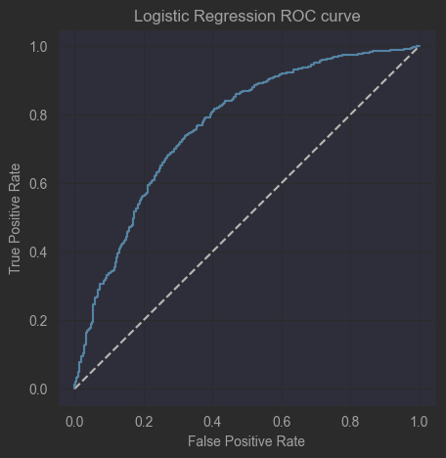

Before oversampling
After oversampling

Slide 6
POC and Results of the models
The models we chose to use are both the Random Forest and Gradient Boosting Tree models.
Tree based models are a good fit in the world of medicine, since they provide great explainability between the models engineers and the doctors using them.
We removed the “fake” data we got from oversampling, and checked the accuracy, AUC score and ROC curve of these models, and these are the results:
All data (Including SMOTE):
Random Forest: accuracy on test = 0.9175 AUC = 0.9721
Gradient Boosting Machine: accuracy on test = 0.9157 AUC = 0.9696
Clean data (Excluding SMOTE):
Random Forest: accuracy on test = 0.886 AUC = 0.8985
Gradient Boosting Machine: accuracy on test = 0.8725 AUC = 0.8552

Slide 7
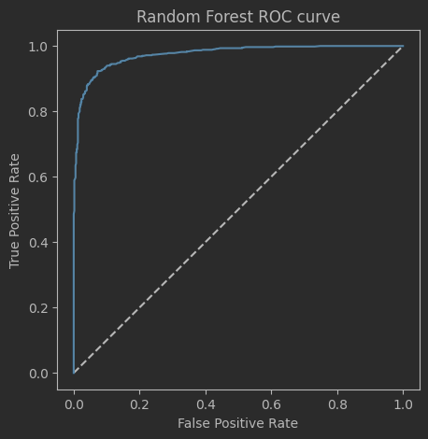
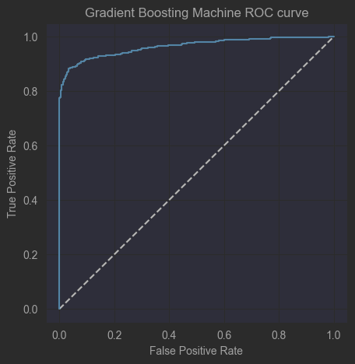
POC and Results of the models

Slide 8
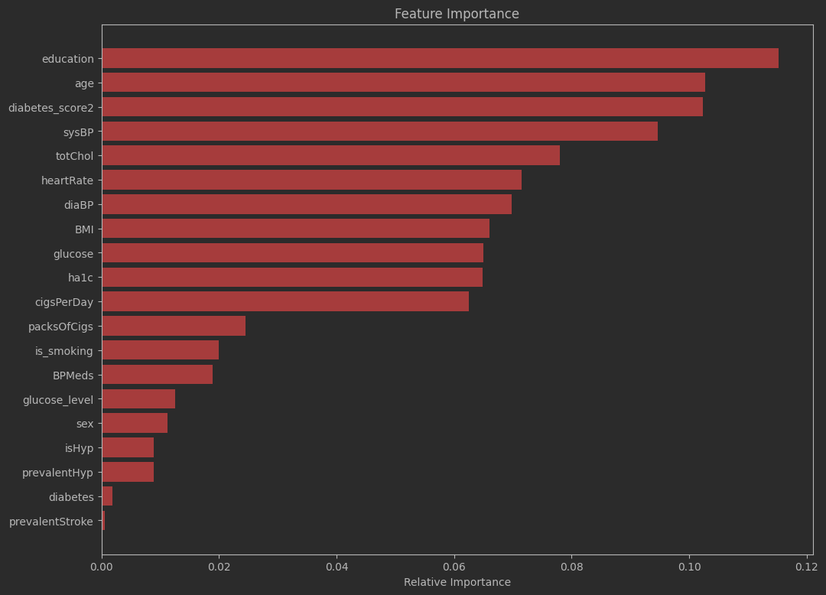

Importance of Features
These are the importance of the features accoring to the Random Forest classifier. We can see the contribution of the diabetes_score2 column added!

Slide 9

But we didn’t stop there

Slide 10
We wanted to use our model to actively help other diabetic paitients. Using the models we developed, we wanted to provide paitients with a pragmatic solution for the unfortunate classification.
We want to answer the question : “What is th minimal path to avoid the cardiovascular complication?”

Slide 11

D.O.C
Diabetic Optimal Counselor

Slide 12

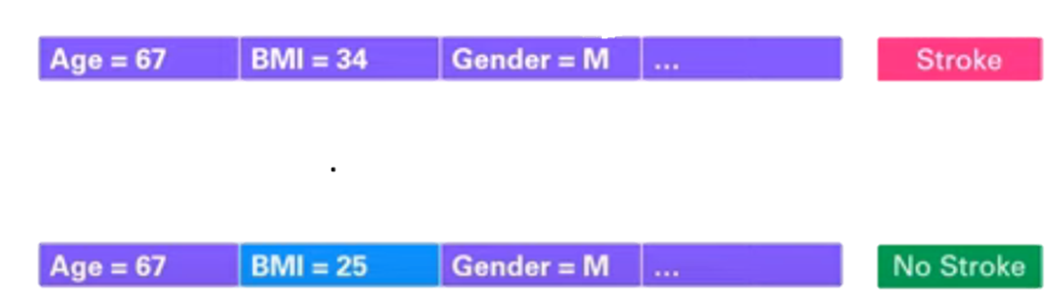
What is a
Counterfactual Example?
A counterfactual explanation (CE) is the minimal change to a datapoint such that after the change, the trained model will flip its prediction.

Slide 13


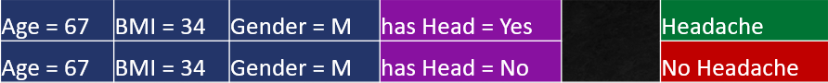
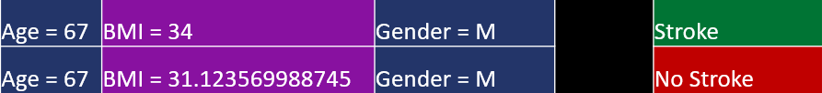
Main problems of CE’s
Purely theoretical (impractical) explanations:
Impossible implementation:
Unrealistic implementation:

Slide 14

Optimization
The algorithm we use for optimization, can find a robust, minimal and optimal change to measured values. Using those, we can develop a plan for the user to better his situation through improving his habits and lifestyle!
The optimizer, developed in a noval article we used, is capble of solving all problems mentioned using various models like Decision Trees, Random Forest, XGBoost and even simple Neural Networks!

Slide 15

Demonstration

Slide 16

D.O.C - Vision
NEW SAMPLE
Patient sends a new sample
Using our model, we predict their risk
PREDICTION
OPTIMIZER
Build a plan of implementation for the patient, and update results
If risk is high, find a minimal robust CE
TRANSLATE
Translate desired changes in values, into desired actions
BUILD PLAN

Slide 17
Refrences
“Finding Regions of Counterfactual Explanations via Robust Optimization”, 2023, Maranago et. al.
“SCORE2-Diabetes: 10-year cardiovascular risk estimation in type 2 diabetes in Europe”, 2023, L. Rydén et al.

Slide 18




Thank You!
From Team Alpaca

